Slide 1
Online College Event
Management
System
Effort By :- Priti Maurya
Guide by:- Mrs. Pallavi Ahire

Slide 2
Contents
Introduction
Project Purpose
Project Scope
Problem Statement
Modules
Flow Chart
Modules image
Related System Analysis
Testing approach
Problem Solution
Project Limitation
Security System
Future Scope

Slide 3
The project brings the entire manual process of Intercollege event management online which is built using Asp .Net as a front end and SQL Server as a backend.
The main purpose of this project is to simplify the process of handling each event by providing a web interface for admin, teacher and students.
The admin part consists of multiple modules where admin or the authorized person need to register the college name to initiate/create the event by adding the type of event (indoor or outdoor).
System allows admin to add teachers who will conduct the particular event activity which is allotted by the admin itself, also can view the student registration for a particular event and lastly, viewing the results of all events held in college. The teacher part has come up with handling all the event related activity assigned by the admin. Teacher performs various task such as taking the attendance of the students who are registered for a particular event, viewing the list of students to mark the winner of each round, generating the results based on multiple rounds won by the student and also can view the 1st, 2nd and 3rd standings of student’s name for the particular event.
Student interface consist of viewing and getting registered for the event of their choice, pay the event activity fees if applicable and can view all the registered events.

Slide 4
Advantages
Overcomes the dependency of a single person handling all the activities.
Students could easily register for the event of their choice.
Multiple teacher can use the web interface to login and perform the desired task.
Easy results generation and view rankings.
Easy to access the system anywhere and anytime.
Disadvantages
Requires an active internet connection.

Slide 5
Introduction
College Event Management System is a web Application which is used to manage the Participants Information, Events Information and generate the various reports.
The System will consist of various modules like Registration System, Login System, Payment System, Participation in various events .
In a recent time, to engage students and prepare them for the real world. college and universities organize college fest and encourage the participate and showcase their latent talent. Student put their best efforts to make college fest entertaining and exciting. These amazing college fest play a significant role in shaping the career of a student
Provide Educational Benefits, promote social interaction.

Slide 6
Purpose
Scope
The aim of purposed system is to develop a system of improved facilities.
the proposed system can overcome all the limitation of the existing system.
The system provides proper security and reduces the manual work.
1. security of data.
2. minimize manual data entry.
3. minimum time needed for the various processing.
4. greater efficiency.
5. better service.
6. user friendliness and interactive.
7. minimum time required.

Slide 7
Problem Statement
Problems in existing system
It was limited to a single system.
It was less user-friendly.
It have a lots of manual work .(Manual System does not mean that we are working with pen and paper, it also include working on spread and other simple software’s).
It requires more number of Volunteer need to work.
It was time Consuming process.
The present System was very less secure.
It unable to generate different kinds of report.

Slide 8
Module
Activity Diagram
An activity diagram visually
presents a series of actions
or flow of control in a system
similar to a flowchart or a
data flow diagram.

Slide 9
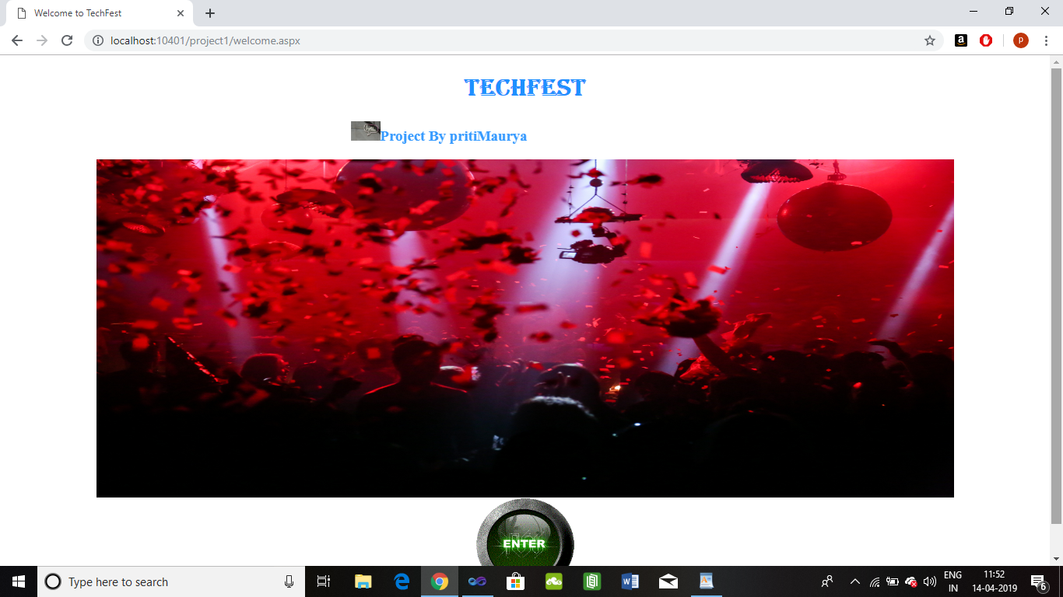
Module
Basic Module
Welcome Page
In this system two module are there
User
Admin
1.User:-
User a person who Participates .
Each user have individual account.
The options given to each registered user are:
Login and Logout.
Register.
Different type of events user can participate.
Get the information about events.
Give feedback .

Slide 10
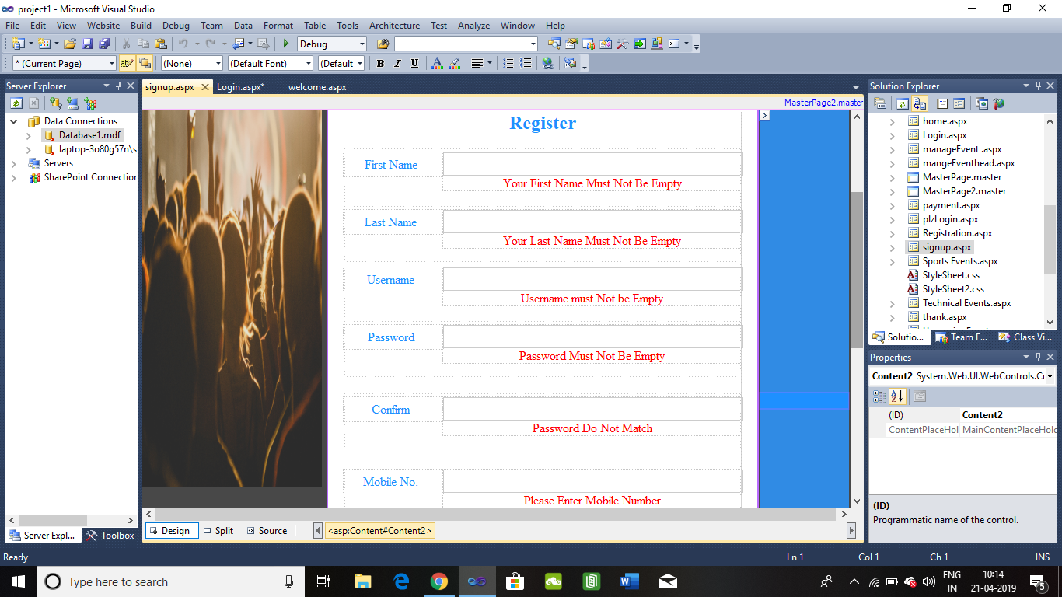
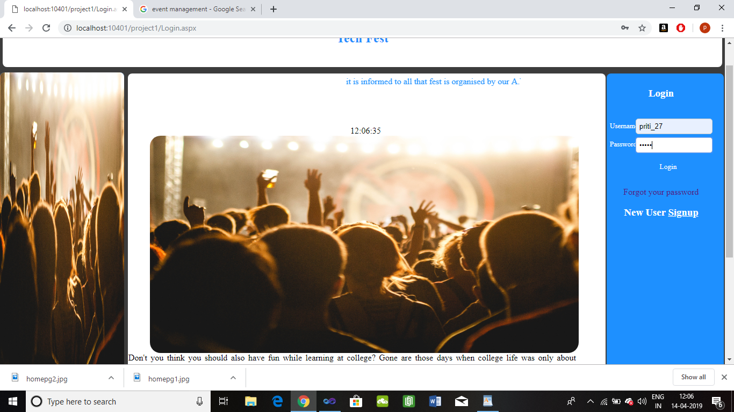
Registration page
Login Page

Slide 11
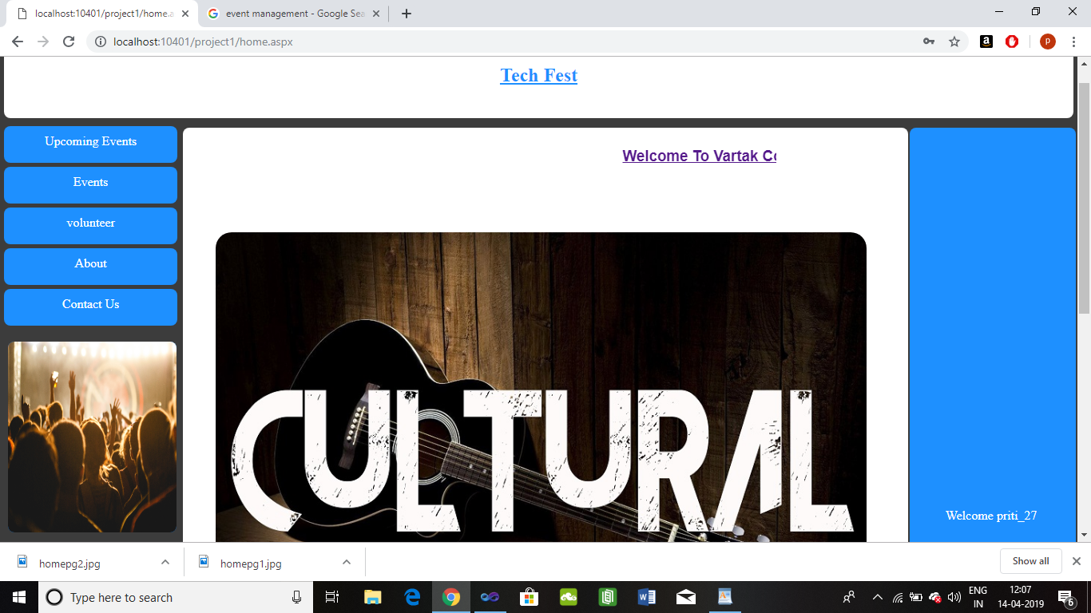
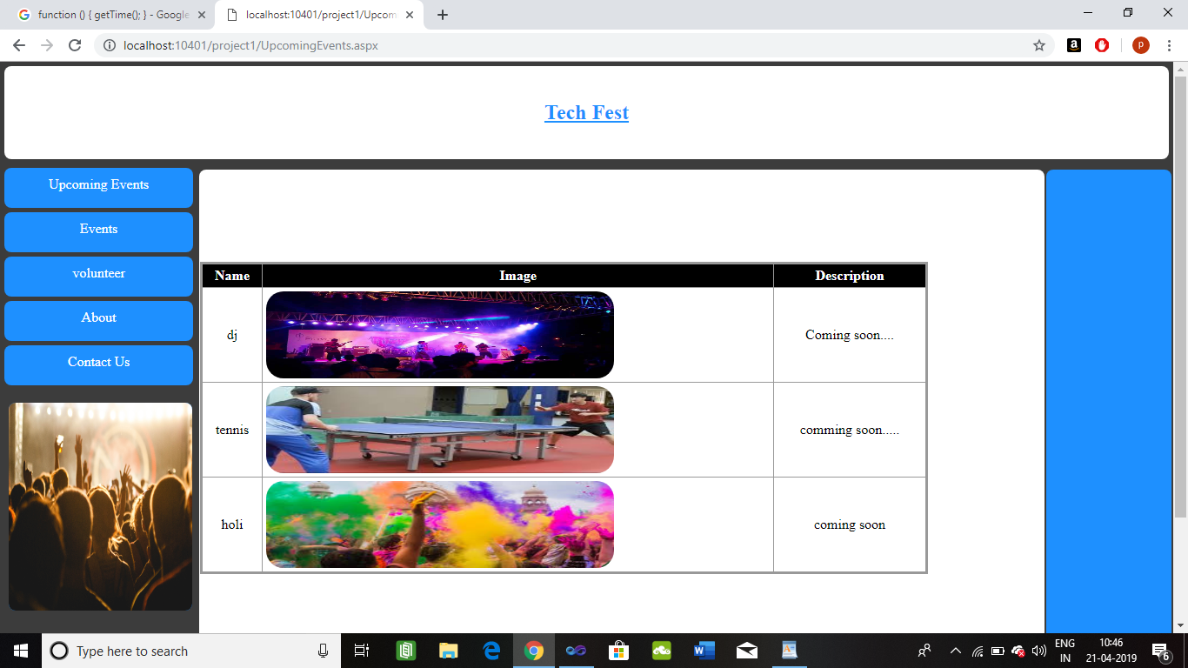
Home Page
Upcoming Event

Slide 12
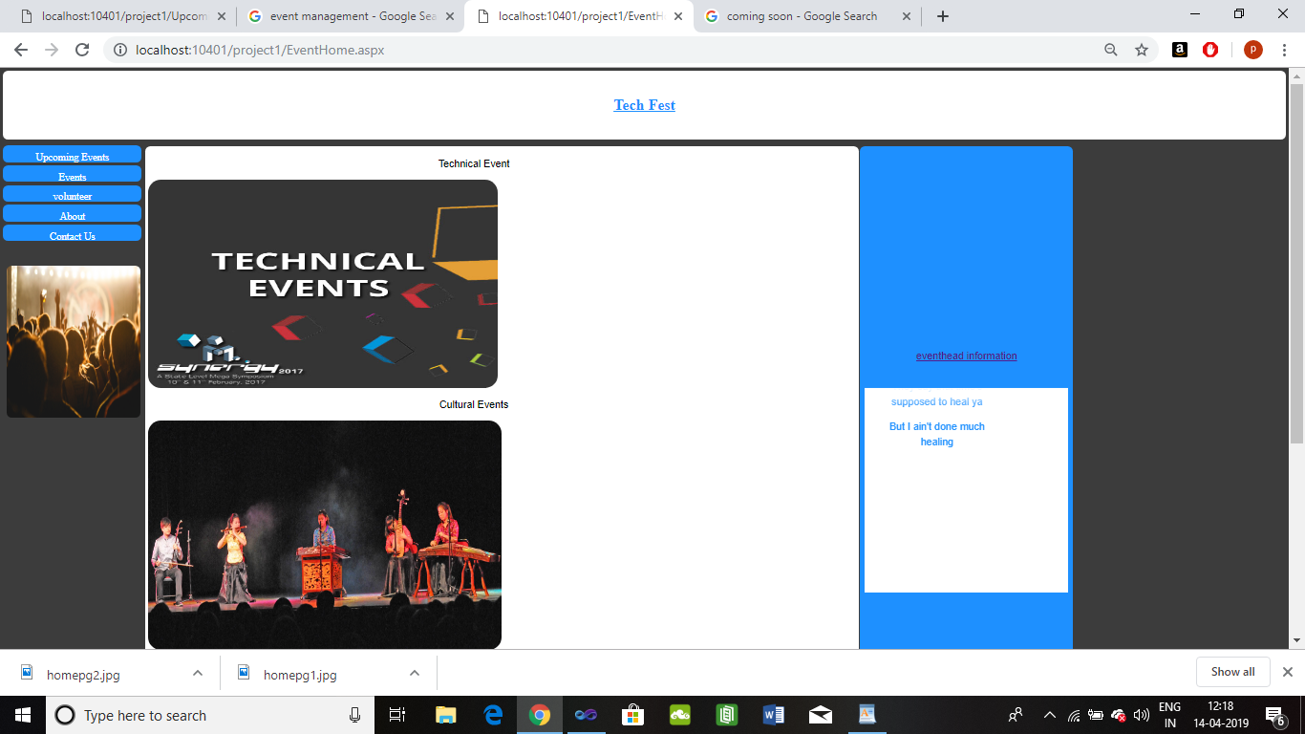
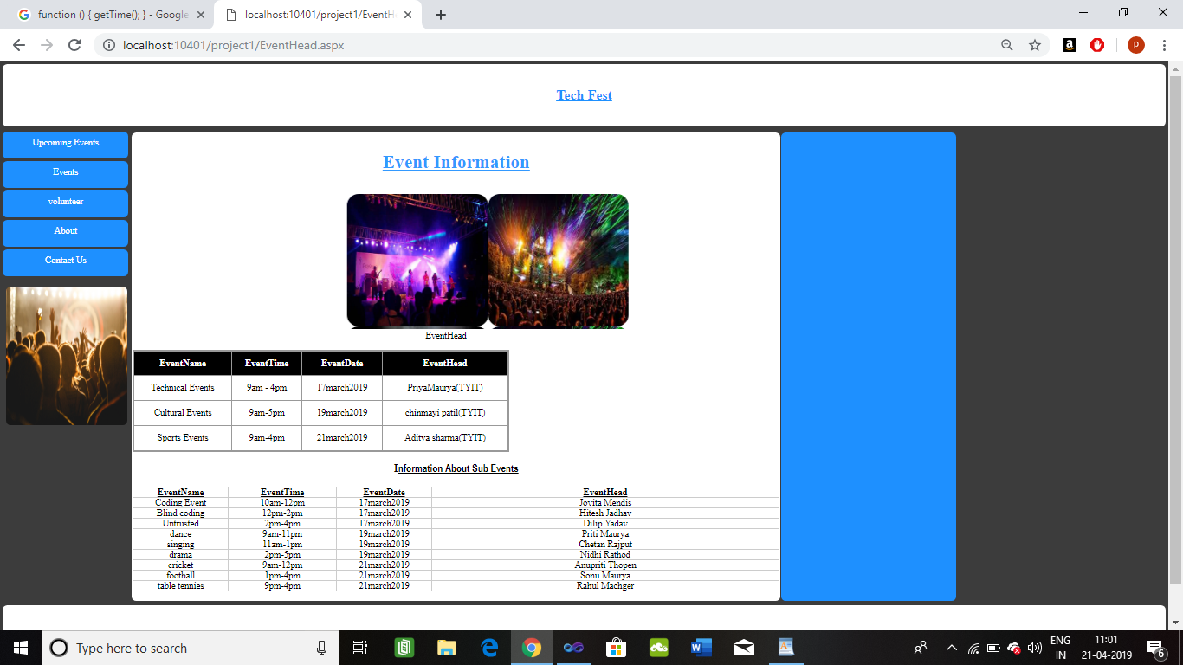
Event Home page
Event Info page

Slide 13
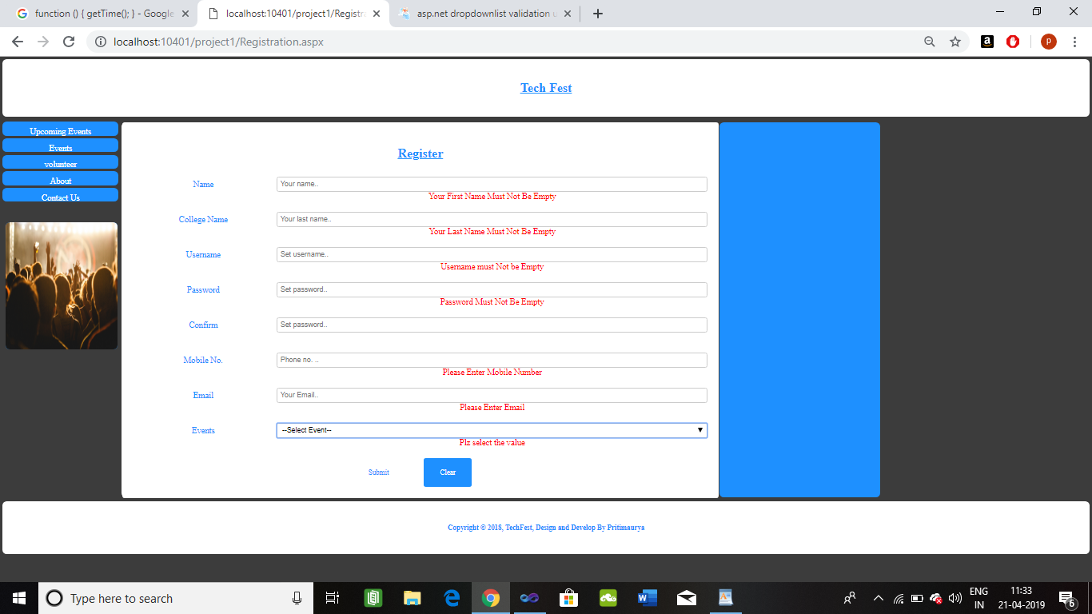
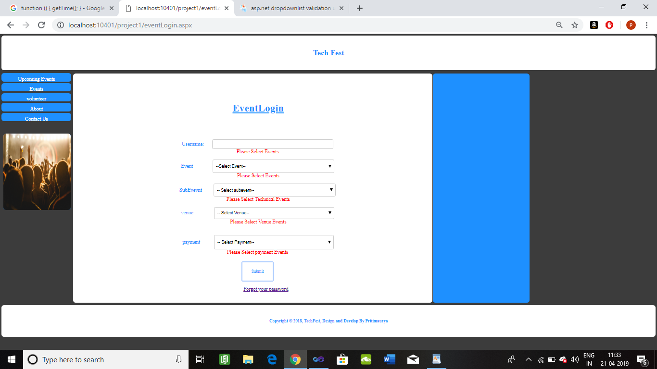
Event Registration
Event Login Page

Slide 14
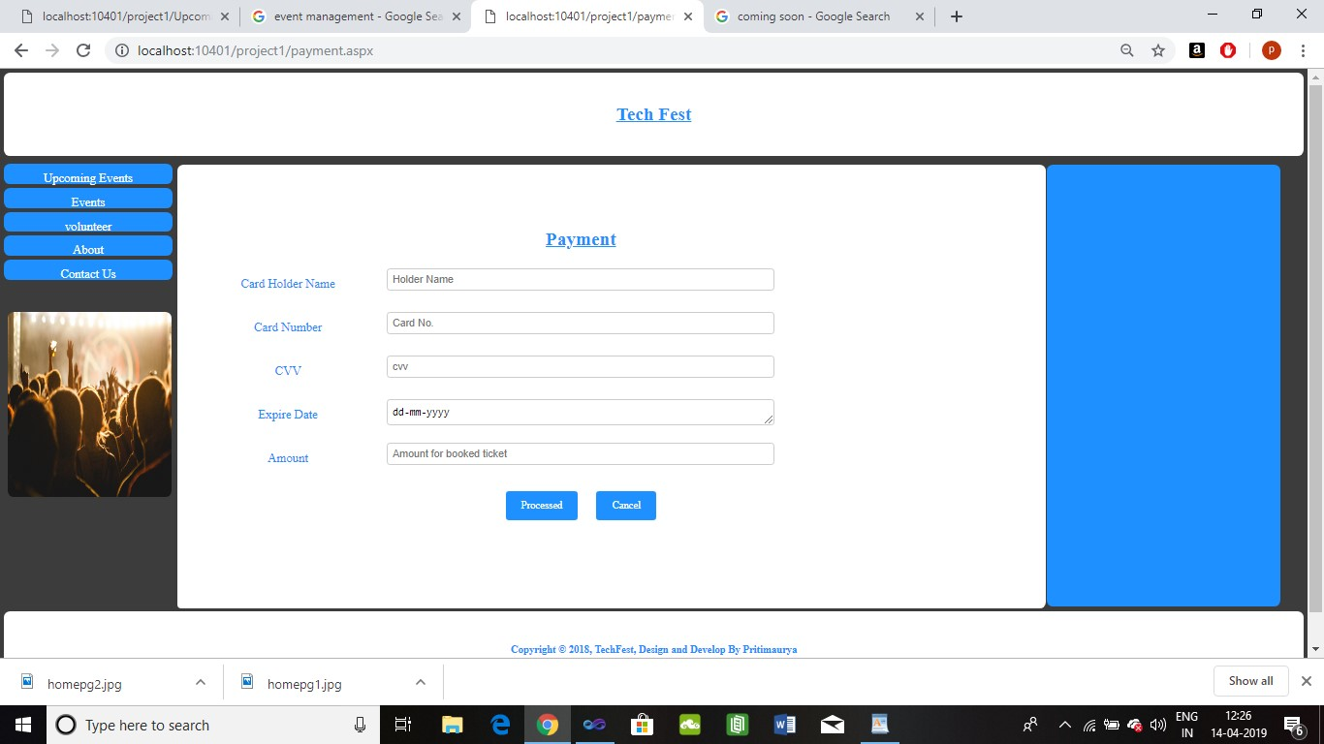
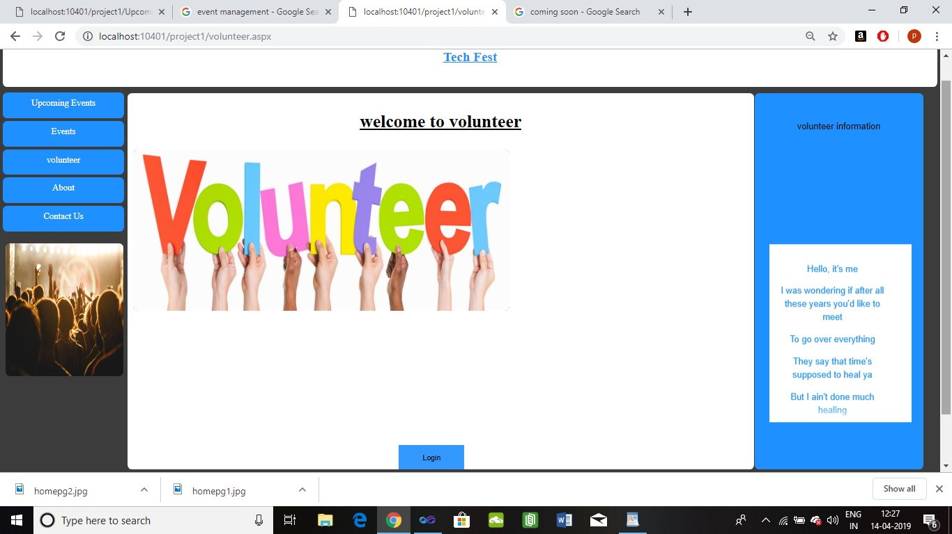
Payment page
Volunteer Home Page

Slide 15
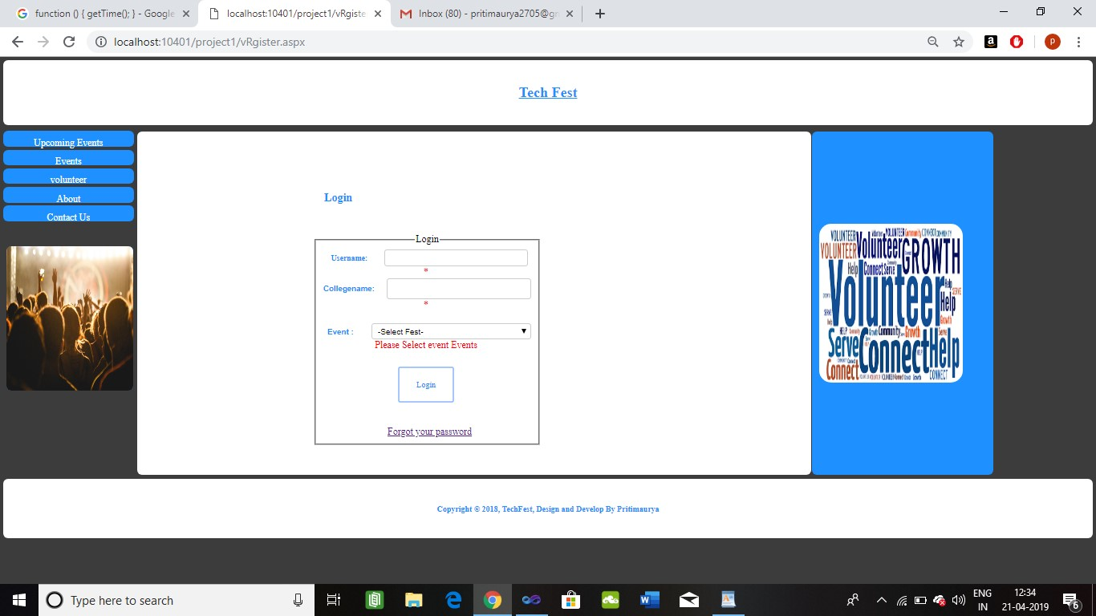
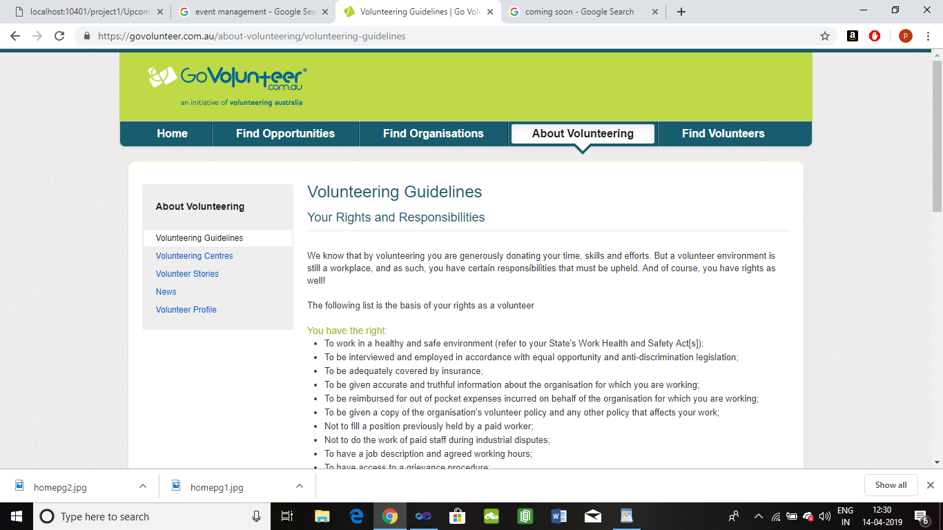
Volunteer Login page
Volunteer Guidelines

Slide 16
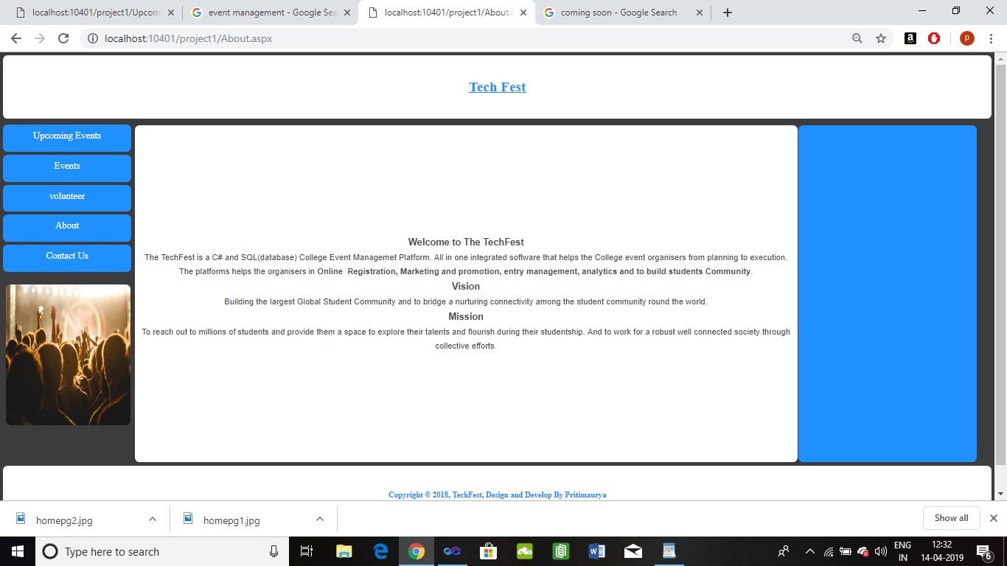
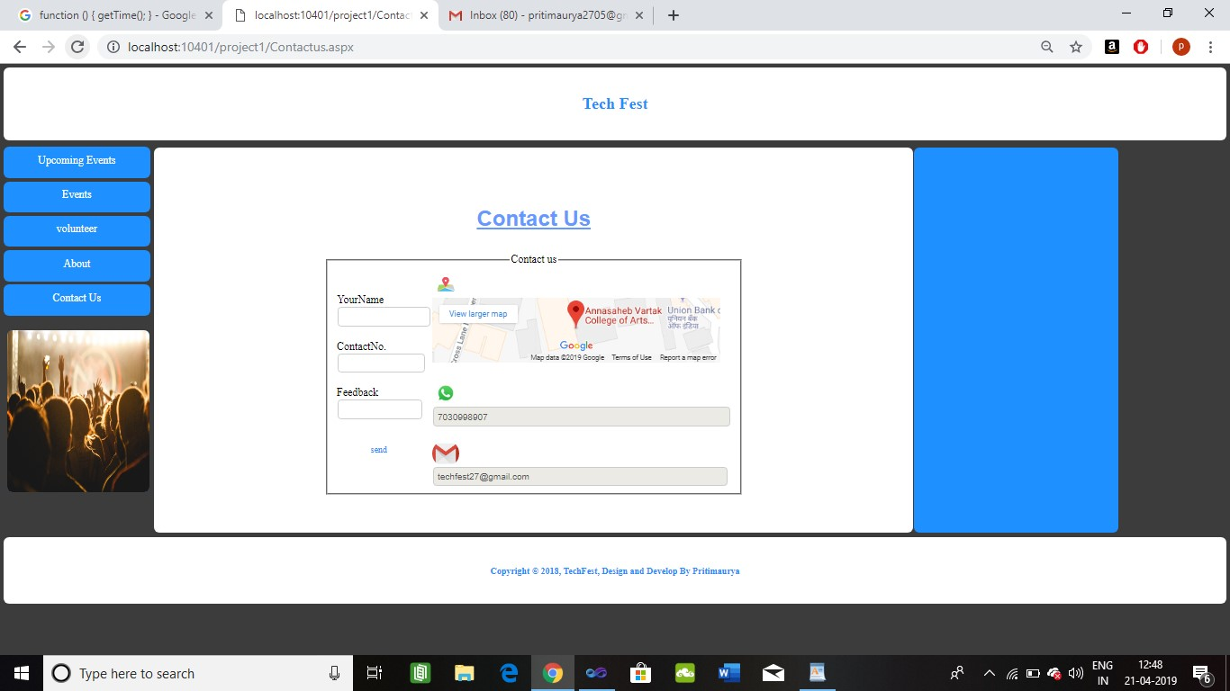
About page
Contact us/Feedback

Slide 17
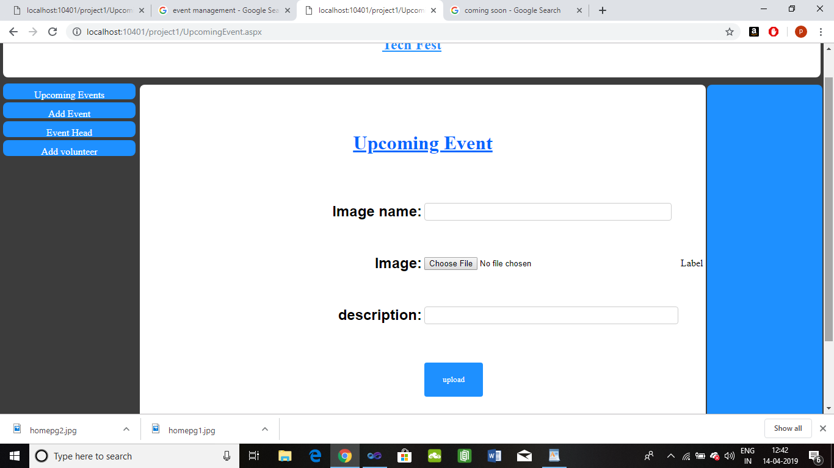
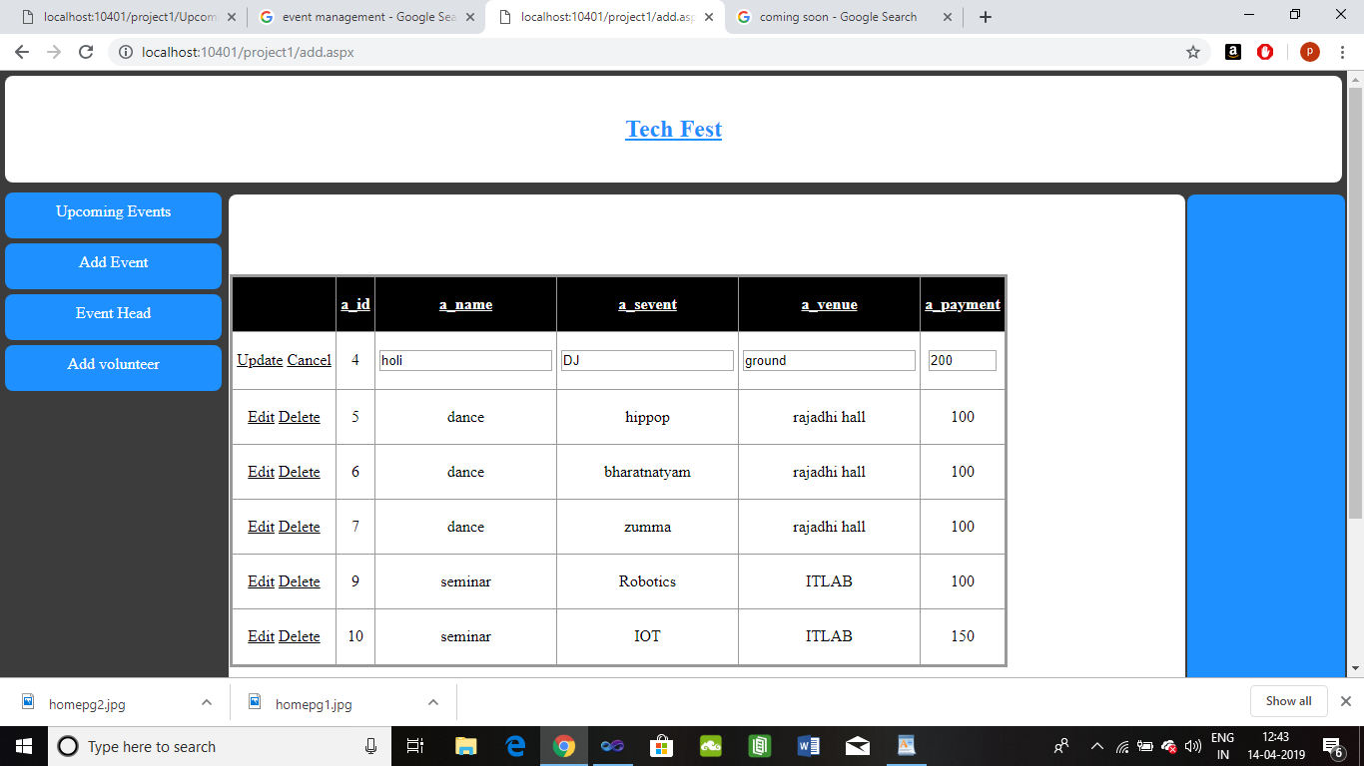
Admin
Upcoming Page
Add Event

Slide 18
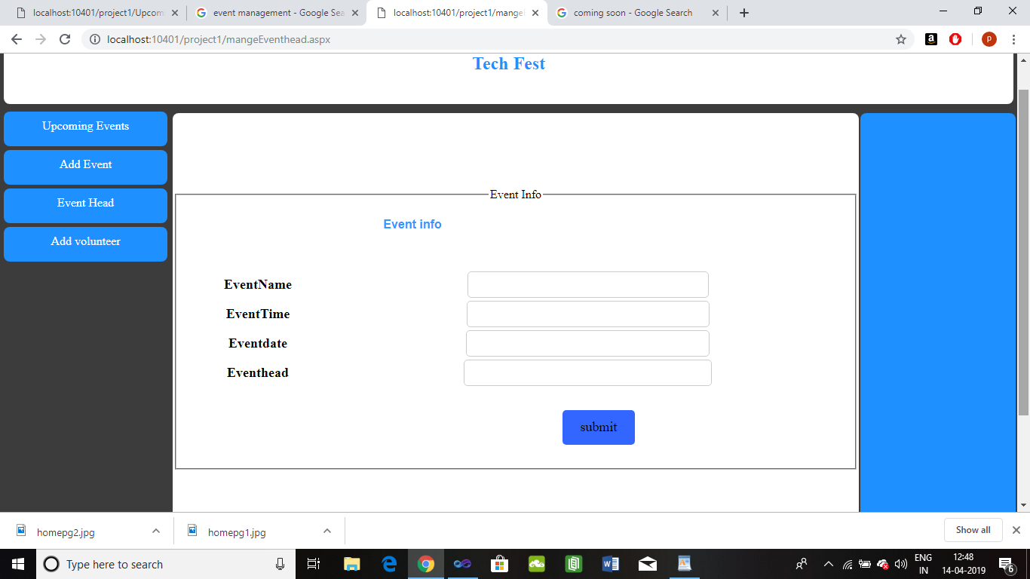
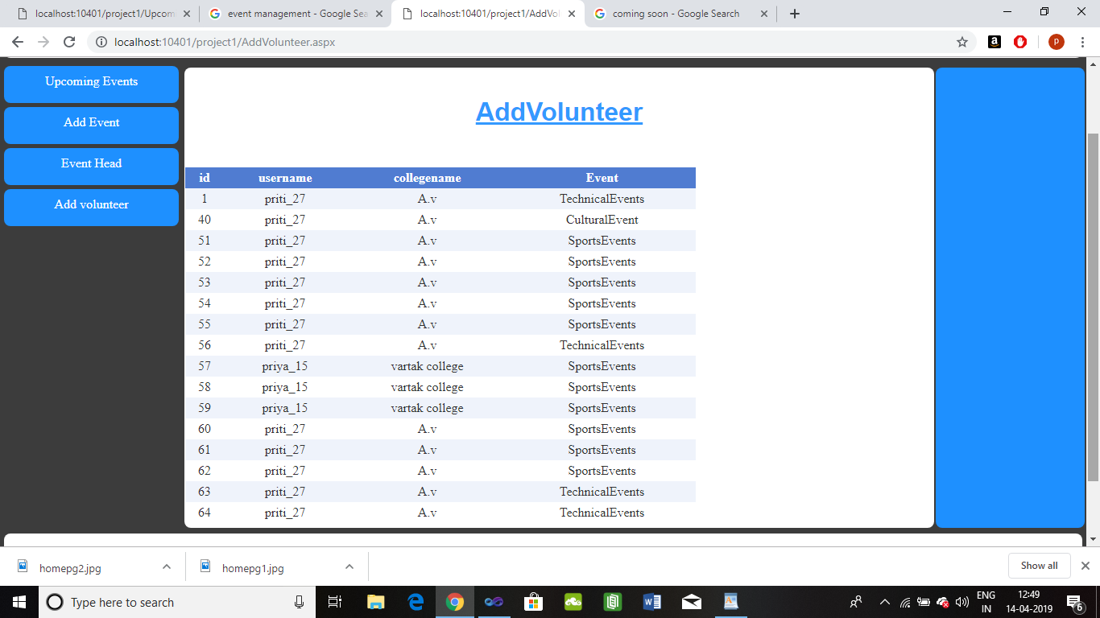
Event Head
Add Volunteer

Slide 19
Testing
Unit testing
Integration testing
Beta testing

Slide 20
Solution to these problems
User friendliness is provided in the application with various controls.
The system make the overall project management much easier and flexible.
It can be accessed over the Localhost.
There is no risk of data miss management at any level while the project development is under process.
It provides high level of security using different protocols like http etc.

Slide 21
Limitations
This activity requires a precise definition of the problem in user term in order to Understand and come up with a solution to solve it efficiently.
A clear statement of the problem is crucial to the success of the web application.
A lot oh human effort or labor us wasted in maintaining the Records, and the record is always prone to human errors.
Keeping recording for every and respective service required for the client in the register stakes more time and is a tedious job.
Lacks reliability and no guarantee of sure end results.
The existing system doesn’t provide any tool to analyze the trends in the event management.

Slide 22
Security System
Admin can do any kind of update ,accept ,insert related operation.
User can only operate his/her own account.
No one can put information by using any software to fill up our registration sector.

Slide 23
Future Scope
1.We can give more advance software for college event management System include more facilities.
2.Create the master and slave database structure to reduces the overload of the database queries.

Slide 24


